Slide 1


Customer_Retention_casestudy
By – Santosh Reddy

Slide 2
Problem statement
Customer satisfaction has emerged as one of the most important factors that guarantee the success of online store; it has been posited as a key stimulant of purchase, repurchase intentions and customer loyalty. A comprehensive review of the literature, theories and models have been carried out to propose the models for customer activation and customer retention. Five major factors that contributed to the success of an e-commerce store have been identified as: service quality, system quality, information quality, trust and net benefit. The research furthermore investigated the factors that influence the online customers repeat purchase intention. The combination of both utilitarian value and hedonistic values are needed to affect the repeat purchase intention (loyalty) positively. The data is collected from the Indian online shoppers. Results indicate the e-retail success factors, which are very much critical for customer satisfaction.

Slide 3
By seeing the problem statement we can tell that we dont need to build any model, we have to just make an analysis of the dataset.
Data Scientists have to apply their analytical skills to give findings and conclusions in detailed data analysis written in jupyter notebook . Only data analysis is required.
The data is collected from the Indian online shoppers. Results indicate the e-retail success factors, which are very much critical for customer satisfaction.

Slide 4
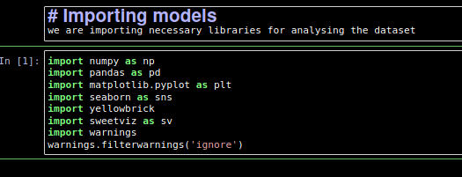
Importing the necessary libraries
We are going to import necessary libraries to use in the project
We imported some of the libraries that are mainly useful for analyze the dataset,there are other libraies which will be imported in the flow of prject

Slide 5
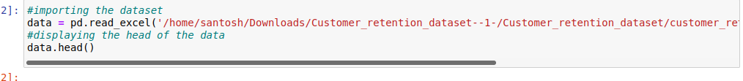
Importing the data set
Now we have to import the data set in pandas we have read_csv function in the pandas to load the data set
We have imported the the data set lets check the shape of the data set and it has any null values

Slide 6
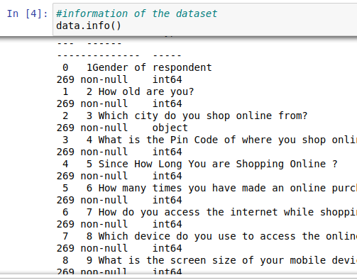
Exploratory Data Analysis
This is the step where we are going to analyze and represent dataset in visual way and we have to see if there is any pattern in the data so we have to use them for feature engineering
Lets stat with shape and
information of data-set in
pandas we have .shape
and .info() methods which
shows us information and
shape of the data

Slide 7
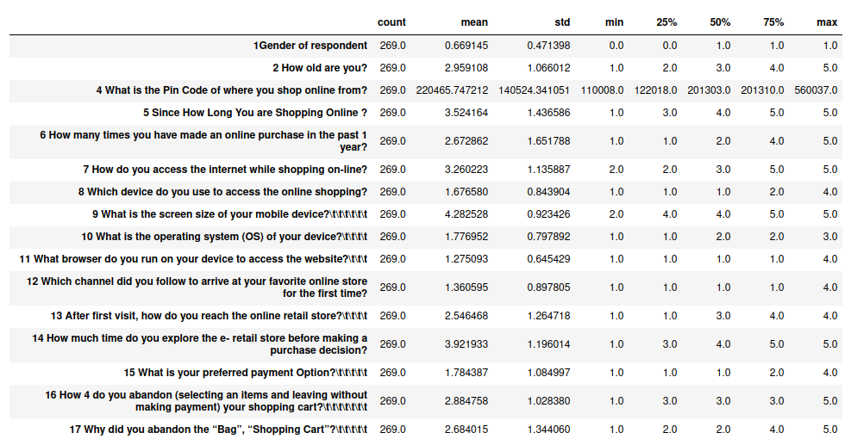
Describe function in pandas helps in the to get details about the statistical data like mean, median, std and percentiles of the data

Slide 8
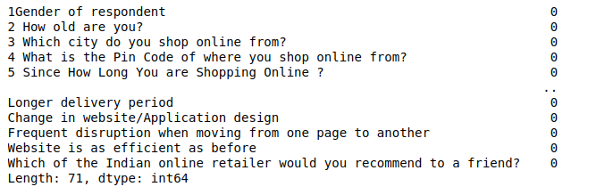
We have to check the null values in the data set, in
pandas we have .isnull() method to see the null values
in this data set we don't have any null values
Lets proceed further
When come to the visualization we have some
visualization libraries we have used in this project are
Matplotlib
Seaborn
Sweet viz
yellow brick

Slide 9
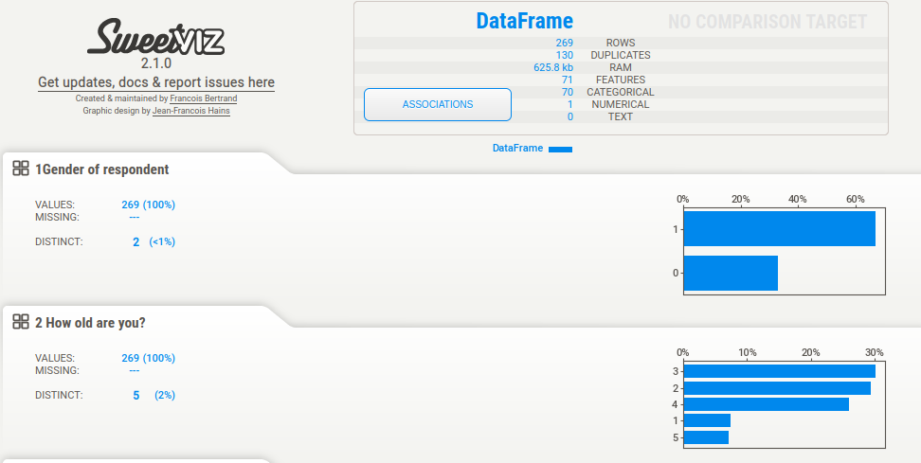
I am using sweet viz library to generate a html report of the project

Slide 10
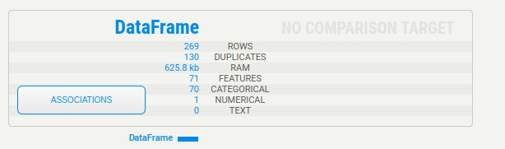
With sweet viz we can generate report for the data like the screen shot above, we will have plots for every variable that helps for analyzing the data
Actually our data is pretty big that normal libraries to handle
It tells us details about numeric, categorical data and other details , rows and duplicates
In EDA we basically check about outliers, skewness and atlast about correlation,lets go ahead of correlation

Slide 11
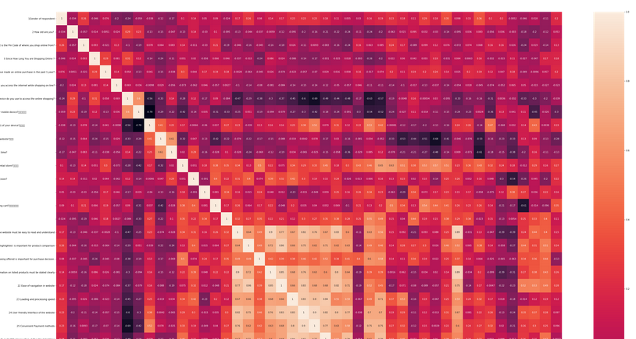
Correlation:
Correlation is defined as relation between two variables on how data is influenced by the change of another variable so lets check that

Slide 12
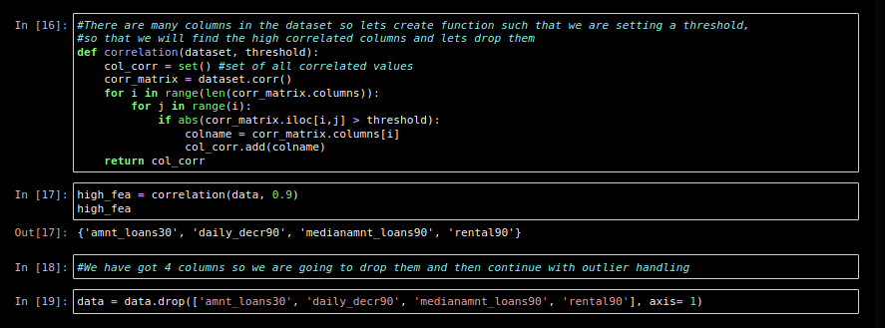
I have used heat map for correlation representation . Since there are more columns we cant tell which is highly correlated so, I am going to create a function that gives us the results so we can drop those columns
We are done with the correlation lets continue with outliers

Slide 13
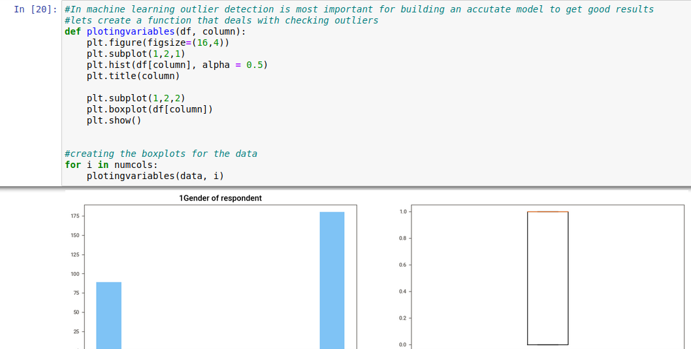
Outliers:
Outliers are the most important important thing to handle in machine learning project cycle , it has huge impact on model creation and prediction

Slide 14
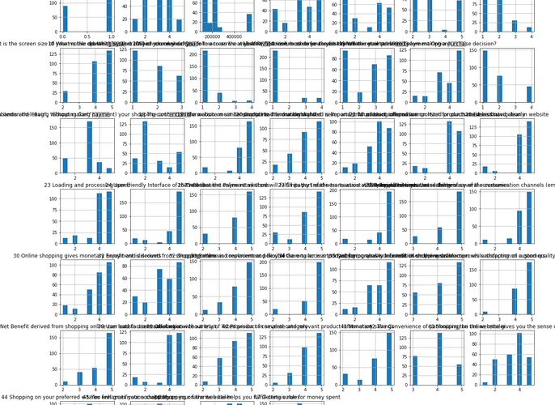
Outliers:
We will check the distribution of the data by using histplot

Slide 15
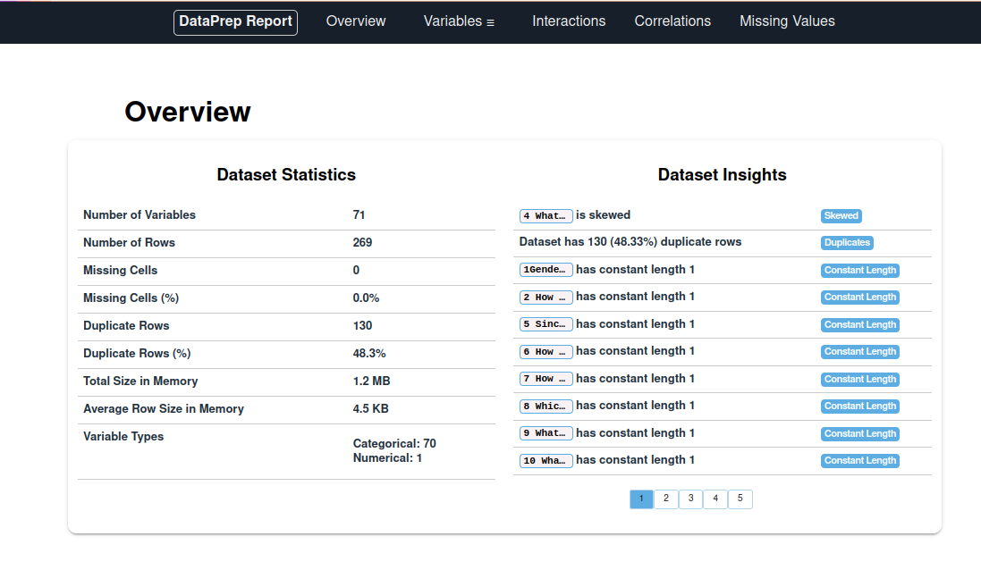
We will use another automated EDA which is called data prep where it generates reports for data analysis

Slide 16
Conclusion
So after all those steps in the in analyzing the details we found is that people are more preferable with e commerce sites like amazon and flip-kart as it is user friendly, with great products, and available all over India with great speed and availability

